Slide 1
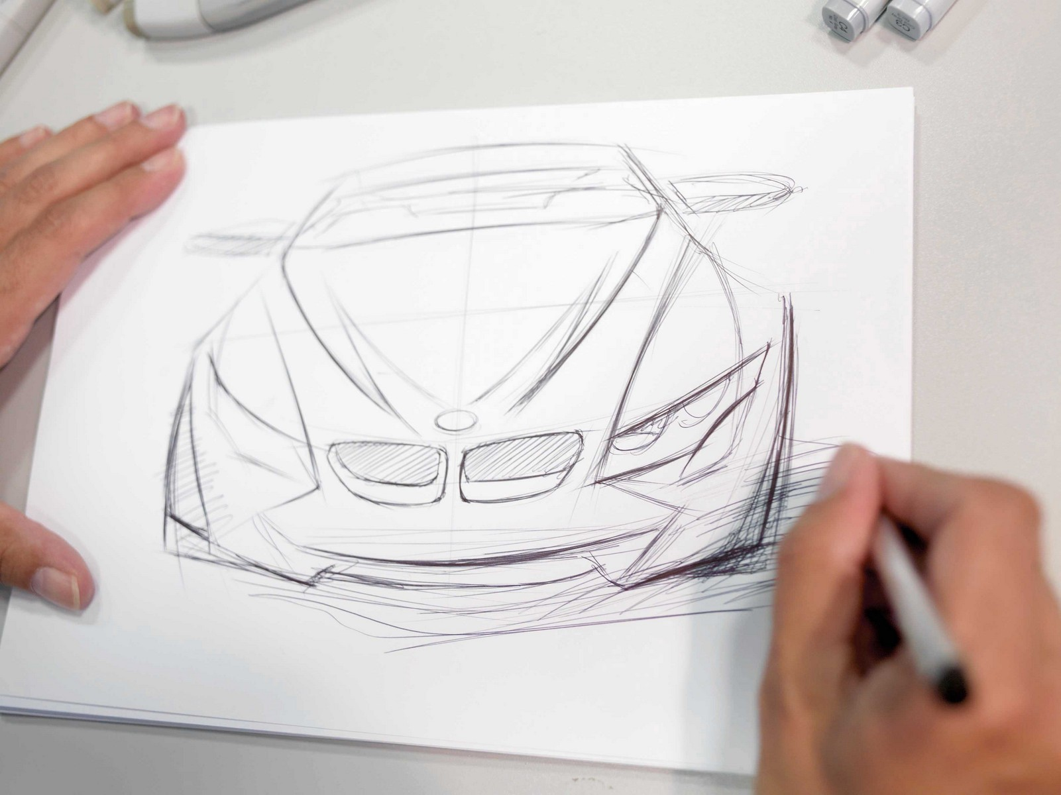
INTRODUCTION
Vehicles at the very early stages of the design consist only of perspective drawings and mental concepts ,and some preliminary defined
requirements
Ref: http://www.bmwblog.com/2012/03/01/
the-design-process-at-the-bmw-group/

Slide 2

INTRODUCTION (cont.)
Little or sometimes no information what so ever to start from
(NO structure, NO materials, etc.)
- Something has to ignite the spark of design!
How about starting from the car crash point of view!!
CRASH DESIGN
REST OF THE CAR DESIGN
Ref: http://idealistcareers.org/5-resources-for-young-
professionals-in-need-of-a-career-igniting-spark/

Slide 3

INTRODUCTION (cont.)
Engineers start the design of the frontal crash box by inserting a collection of deformable rods and elements just like a buzzle
Ref: http://www.ministryinsights.com
/puzzle-strengths-part-3-
missing-puzzle-piece/

Slide 4
INTRODUCTION (cont.)
- After they do that, they start to assess their design on the sequence it will follow to deform
- As it will be explained later, the sequence or as it was called "ORDER OF DEFORMATION” or “OoD” has so many possibilites
- Each possibility can lead to different result with respect to the acceleration and the energy absorption of the crash

Slide 5
INTRODUCTION (cont.)
Engineers are still trying to figure out ALL of the possible OoDs using paper and a pen!!

Slide 6
MOTIVATION
- In order to accelerate this initial design step, we should be able to integrate the computer somewhere within
- The role of the computer comes write after the engineer proposes the design “shape” of the rods’ structure
- In a matter of seconds, it can give the engineer all of the possible sequences and which one corresponds to the given mass and material data
- Afterwards, any further adjustments can be easily implemented

Slide 7
PROBLEM STATEMENT
The problem statement is summarized in the following two points:
1- The software should be able to identify ALL of the possible OoDs
2- It should be capable of defining which one of these OoDs is going to be generated for the specific masses and material properties of the car

